Slide 1
Group 387: Finding the best classifier to predict credit card fraud detection
Group member:
Vikas Sanil – vsanil1@hawk.iit.edu

Slide 2
Data:
Found data: From Kaggle datasets: https://www.kaggle.com/datasets/mlg-ulb/creditcardfraud
Source: Machine Learning Group – ULB
Data Type: Anonymized credit card transactions labeled as fraudulent or genuine
Content:
The dataset contains transactions made by credit cards in September 2013 by European cardholders. This dataset presents transactions that occurred in two days, where we have 492 frauds out of 284,807 transactions. The dataset is highly unbalanced, the positive class (frauds) accounts for 0.172% of all transactions.
It contains only numerical input variables which are the result of a PCA transformation. Unfortunately, due to confidentiality issues, the source cannot provide the original features and more background information about the data. There are 31 features. Features V1, V2, … V28 are the principal components obtained with PCA, the only features which have not been transformed with PCA are 'Time' and 'Amount'. Feature 'Time' contains the seconds elapsed between each transaction and the first transaction in the dataset. Feature 'Class' is the label and it takes value 1 in case of fraud and 0 otherwise.

Slide 3
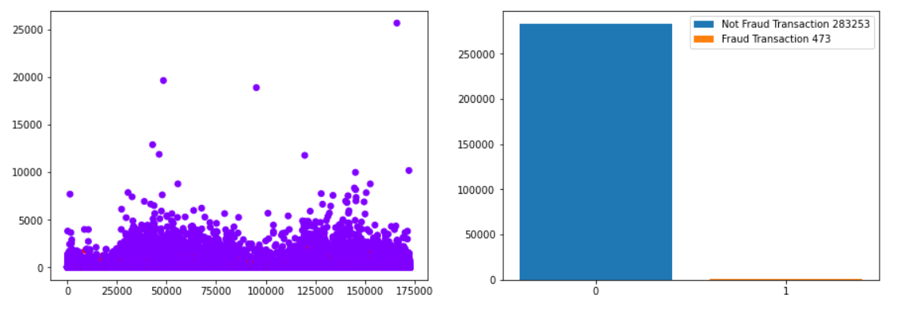
Dataset before data preprocessing:

Slide 4
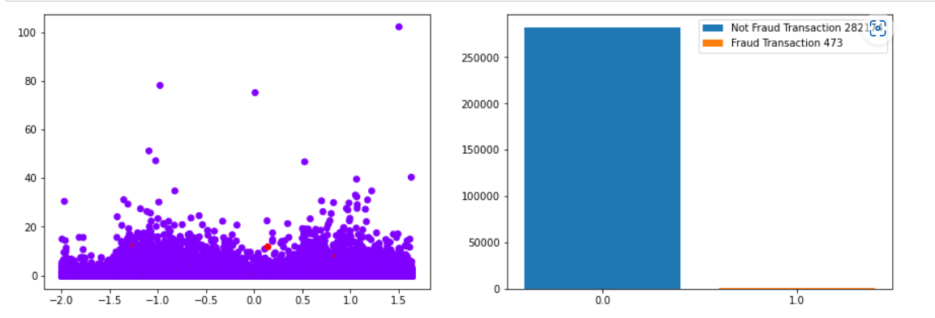
Data after duplicate removal and standardization:

Slide 5
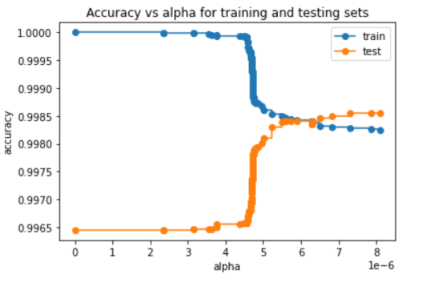
Cost Complexity Pruning Path method result used to find optimal ccp_alpha for Decision Tree:

Slide 6
Classifiers Used:
classifiers = [
DecisionTreeClassifier(criterion='gini', max_depth=1000, ccp_alpha = 5.5),
LogisticRegression(penalty='l2',solver='saga', max_iter=1000),
SVC(kernel="linear", C=0.025, max_iter=1000, probability=True),
SVC(gamma='auto', C=1, max_iter=1000, probability=True),
RandomForestClassifier(criterion='gini', max_depth=1000, ccp_alpha = 5.5, n_estimators=1000, max_samples=0.8, random_state=42),
GradientBoostingClassifier(n_estimators=1000, random_state=42, learning_rate=1.0, criterion='squared_error', max_depth=1000),
GradientBoostingClassifier(n_estimators=1000, random_state=42, learning_rate=1.0, criterion='friedman_mse', max_depth=1000),
HistGradientBoostingClassifier(loss='log_loss', learning_rate=1.0, max_iter=1000, max_depth=1000),
MLPClassifier(hidden_layer_sizes=(10,), solver='adam', random_state=1, max_iter=1000, warm_start=True)
]

Slide 7
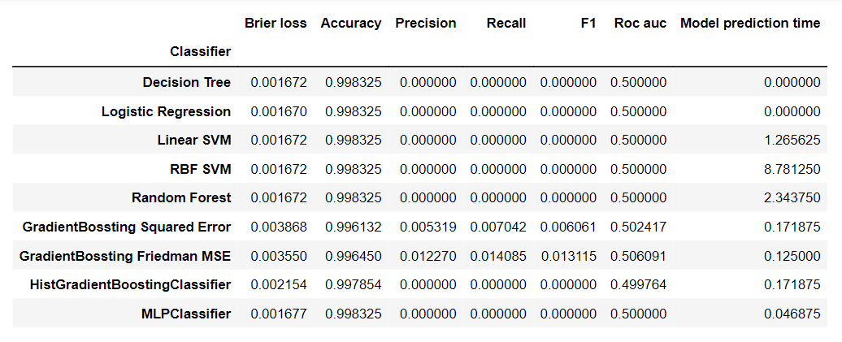
Results on imbalanced dataset with minority positive cases:

Slide 8
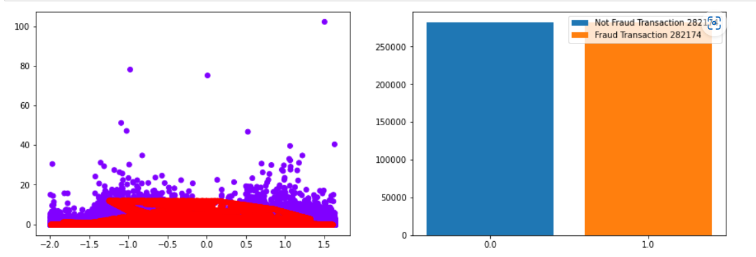
Data after over sampling minority cases using SMOTE:

Slide 9
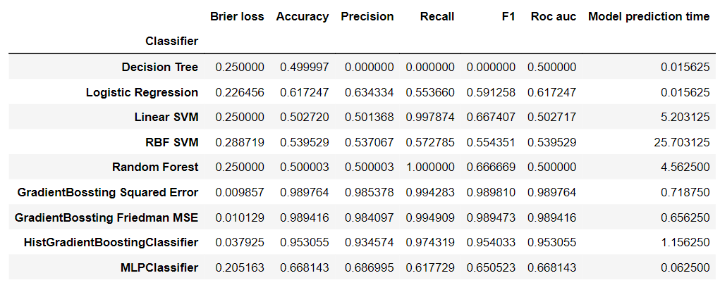
Results on minority cases oversampled dataset:

Slide 10
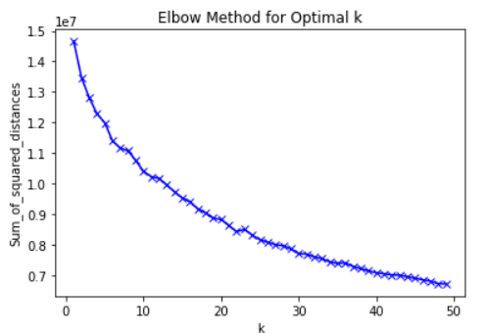
Finding optimal K value for KMeans clustering

Slide 11
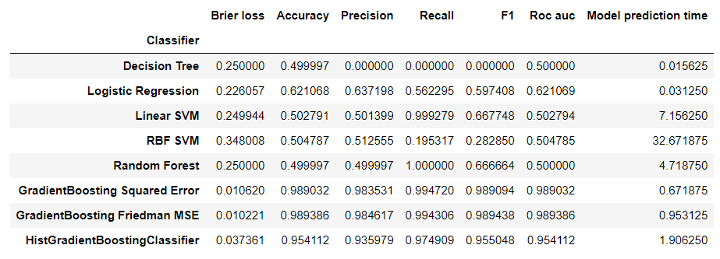
Results on clustered minority cases over sampled dataset:

Slide 12
Comparison of Results:

Slide 13
Conclusion:
Following are the conclusions:
Imbalanced dataset will not yield a good prediction model.
Gradient Boosted Decision Trees has better performing prediction model among Decision Tree, Logistic Regression, Support Vector Machine, Random Forest, Histogram-based Gradient Boosted Decision Trees, and Multi-layer Perceptron for Credit Card Fraud dataset.

